Slide 1

Diminutive suffix productivity
Juan Berríos
LING 2340 – Data Science for Linguists
University of Pittsburgh

Slide 2
introduction

Slide 3

Goals of the project
A cross-dialectal analysis of two competing Spanish diminutive suffixes (-ito, -illo) in terms of productivity; i.e., the extent to which a morphological pattern can be applied to new bases and form new words.
This analysis also considers dialectal variation, given that varieties of Spanish might not necessarily display the same trends.
Goals:
Explore the cross-dialectal distribution of two competing diminutive suffixes in a representative, cross-dialectal corpus.
Apply statistical measures of productivity to the data.
Determine whether differences are reflected across varieties.

Slide 4
The morphological pattern
Diminutivization.
Function: form a complex word denoting a smaller version of the base (Haspelmath & Sims, 2010).
a. un hombre-cito b. muy chiqu-ito
a man-dim.sg very small-dim
“A little man.” “Very small.”
c. com-iend-ito d. ahor-ita.
eat-prog-dim now-dim
“Eating.” “Now.”

Slide 5
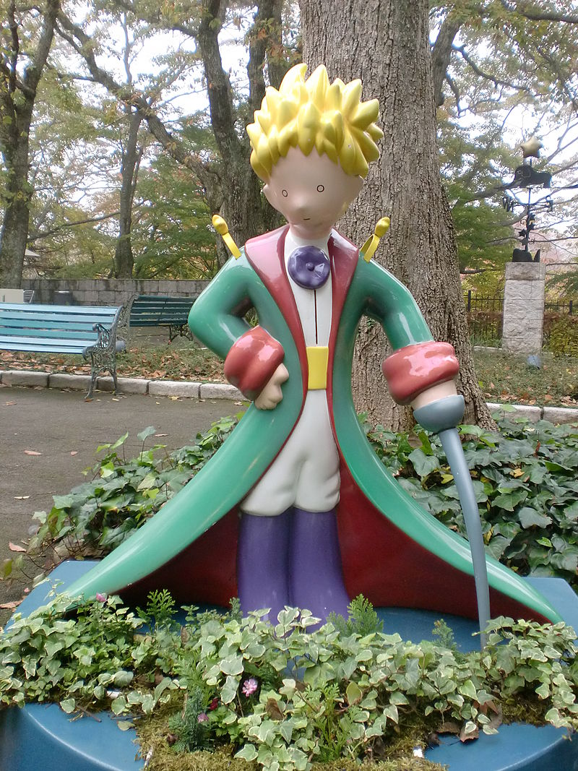
El principito
“The little prince”
By MarieM1FLERéunion – Own work, CC BY-SA 4.0, httpscommons.wikimedia.orgwindex.phpcurid=36689506

Slide 6
background

Slide 7
Diminutive formation
Several productive diminutive suffixes attested in Spanish; notably –ito, -illo, -ico, and -ete (Hualde, 2013).
Attention in the literature from several perspectives, notably from competence-based approaches.
Prior research on diminutive formation has focused on:
The distribution of the allomorphs of -ito (Bradley & Smith, 2011; Eddington, 2002, 2017).
Diminutive formation as explained by different theoretical frameworks, including lexical phonology (Castro, 1998), exemplar theory (Eddington, 2002, 2017), and optimality theory (Bradley & Smith, 2011; Colina, 2003; Elordieta & Carreira, 1996).

Slide 8
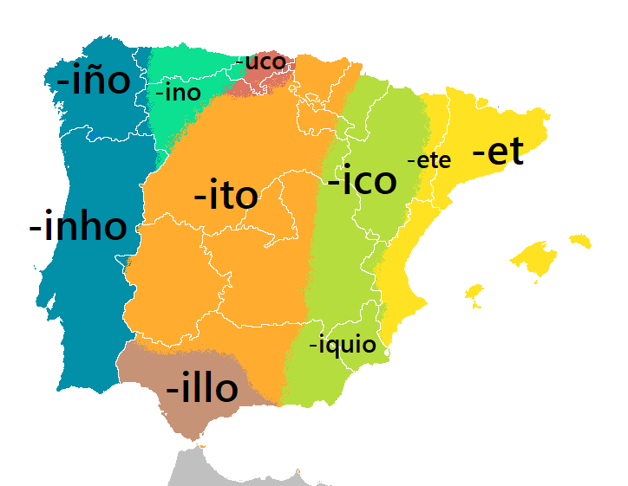
In this project
Focus on –ito and –illo because they are both attested across varieties and because a comparison between them can hence provide a more fine‑grained analysis of productivity.
Despite their similarity, ‑ito is widely agreed to be much more productive (Hualde, 2013; Lipski, 1994; Náñez Fernández, 2006).
https://corpuscuenta.wordpress.com/2016/09/10/los-diminutivos-variacion-formacion-y-usos/

Slide 9
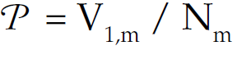
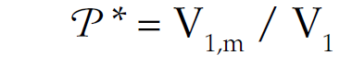
Measuring productivity
Statistical measures of productivity (Baayen, 2009):
1. Realized productivity: size of the morphological category.
Type count of the members of a morphological category in a corpus with N tokens.
2. Expanding productivity: the rate at which a category is attracting new members.
The number of words in a morphological category that occur only once in a corpus of N tokens; the hapax legomena.
3. Potential productivity: productivity as measured by the number of occasionalisms.
The number of hapax legomena in the corpus divided by the total number of tokens affected by the same category. Also known as the category-conditioned degree of productivity.

Slide 10
Research questions

Slide 11
RESEARCH QUESTIONS
What is the productivity of each suffix?
H1: -ito is claimed to be the more productive suffix by far. I expect this to be reflected in the data.
Are the differences statistically significant?
H2: I also expect differences, particularly those of potential productivity, to be significant.
Are differences reflected across varieties?
H3: one of the suffixes (-illo) is claimed to be more productive in Spain.

Slide 12
procedure

Slide 13
data
Corpus del español
https://www.corpusdelespanol.org/
Searchable online
Full corpus available under license
Web / Dialects
Created in 2016
Size: 2 billion words
21 Spanish-speaking countries represented
Fully lemmatized
POS-tagged

Slide 14
Corpus processing
The data set is available in three formats: (i) Database (Structured Query Language), (ii) Word/lemma/PoS, and (iii) linear (raw) text. All are .txt files and the former two are tab-delimited.
Challenges: size, structure of directories, and extraction of relevant rows.

Slide 15
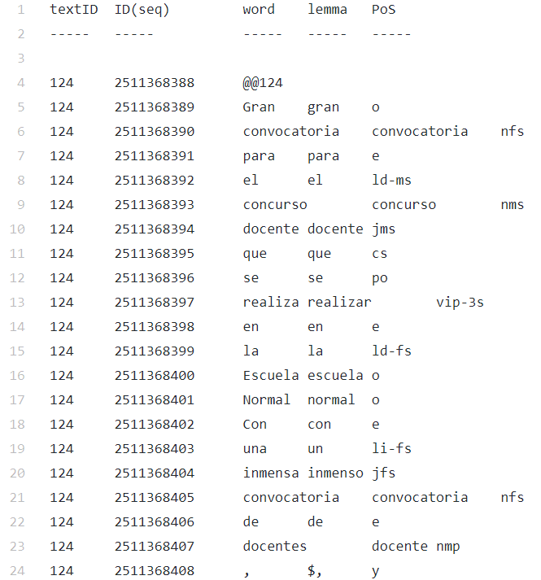
Corpus processing

Slide 16
Corpus processing
Functions created:
toDF
add_variety
remove_syms
remove_nondims
Master functions
corpus_process
extract_hapax

Slide 17
Corpus processing
def corpus_process(fdir, country_df, variety):
country_df = pd.DataFrame(columns=['SourceID', 'TokenID', 'Word', 'Lemma', 'POS'])
for fname in fdir:
df = toDF(fname)
df = remove_nondims(df)
country_df = pd.concat([country_df, df], sort=True)
add_variety(country_df, variety)
return country_df
def extract_hapax(fdir, country_hapax):
country_hapax = set()
for fname in fdir:
df = toDF(fname)
df = remove_syms(df)
df = remove_redacted(df)
hapax = set([w.lower() for w in df['Word']])
for word in hapax:
country_hapax.add(word)
return country_hapax

Slide 18
Corpus processing
Lemma | POS | SourceID | TokenID | Word | Variety
nikita | o | 431270 | 2206403194 | Nikita | ES
escrito | jms | 431270 | 2206403206 | escrito | ES
calladito | j | 431290 | 2074527333 | calladita | ES
sólito | jms | 431290 | 2074527343 | sólito | ES
necesitar | vip-3s | 431310 | 2143630275 | necesita | ES
... | ... | ... | ... | ...
sencillo | jfs | 1891249 | 1779969779 | sencilla | ES
permitir | vsp-1/3s | 1891249 | 1779969895 | permita | ES
inscrito | j | 1891249 | 1779970044 | inscrito | ES
visita | nfp | 1891249 | 1779970074 | visitas | ES
visita | nfp | 1891249 | 1779970084 | visitas | ES
Not diminutives

Slide 19
Cleaning and exploratory analysis
Created a master_DF object.
Removed categories to which the morphological pattern doesn't apply
Refined the POS column
Last step:
There were still many tokens that did not belong in the data frame because they are (i) lexicalized forms that have acquired a meaning of their own, or (ii) words that meet the word class and phonological requirement but simply do not happen to be diminutives.

Slide 20
Cleaning and exploratory analysis
Solution: extract a list of highly frequent forms from the corpus that end in the segments of interest to get a list that I later cross-compared with my data frame's Lemma column. For this purpose, I used a lexicon that is included with the corpus data, loaded it, derived a frequency-based list of lemmas I wanted to exclude from the data frame, and then actually excluded those from the master_DF object.
master_DF = master_DF[~master_DF['Lemma'].isin(lexicalized)]

Slide 21
Cleaning and exploratory analysis
SourceID | TokenID | Lemma | Word | POS | Variety | POS_binary | Number | Gender
1020347 | 2416709509 | monedita | monedita | n | PE | Noun | unknown | unknown
491500 | 459306545 | papelito | papelito | n | ES | Noun | unknown | unknown
349116 | 2599105296 | carretilla | carretilla | nfs | CU | Noun | singular | feminine
1573286 | 2665899879 | morrillo | Morrillo | nms | CU | Noun | singular | masculine
523695 | 925421781 | masilla | masilla | nfs | ES | Noun | singular | feminine

Slide 22
Exploratory analysis

Slide 23
Exploratory analysis
 | Lemma | Word | Variety | POS_binary | Diminutive
count | 1429012 | 1429012 | 1429012 | 1429012 | 1429012
unique | 49526 | 62073 | 20 | 2 | 2
top | poquito | poquito | ES | Noun | -ito
freq | 59520 | 54543 | 383969 | 1170533 | 1195810

Slide 24
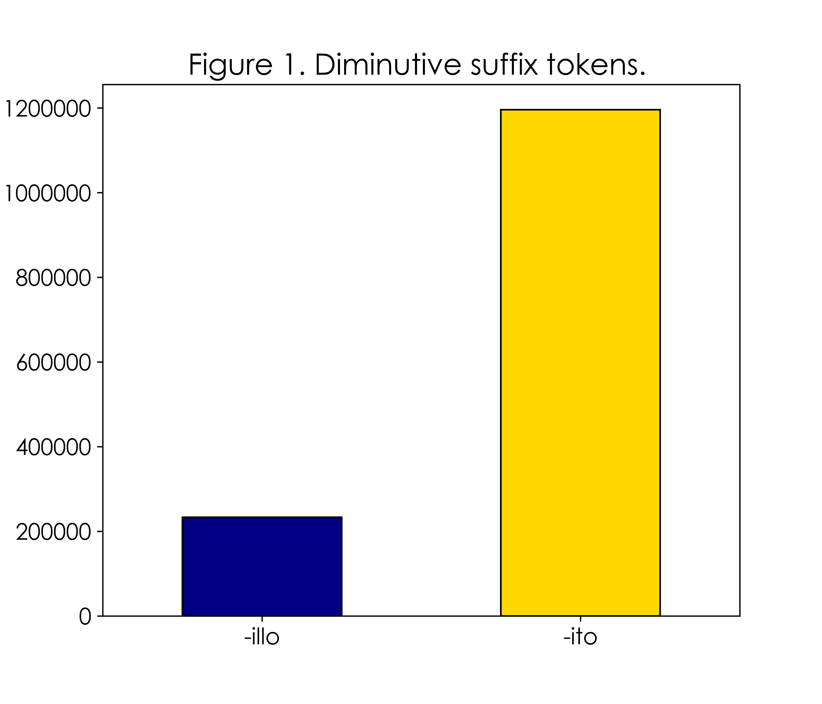

Slide 25
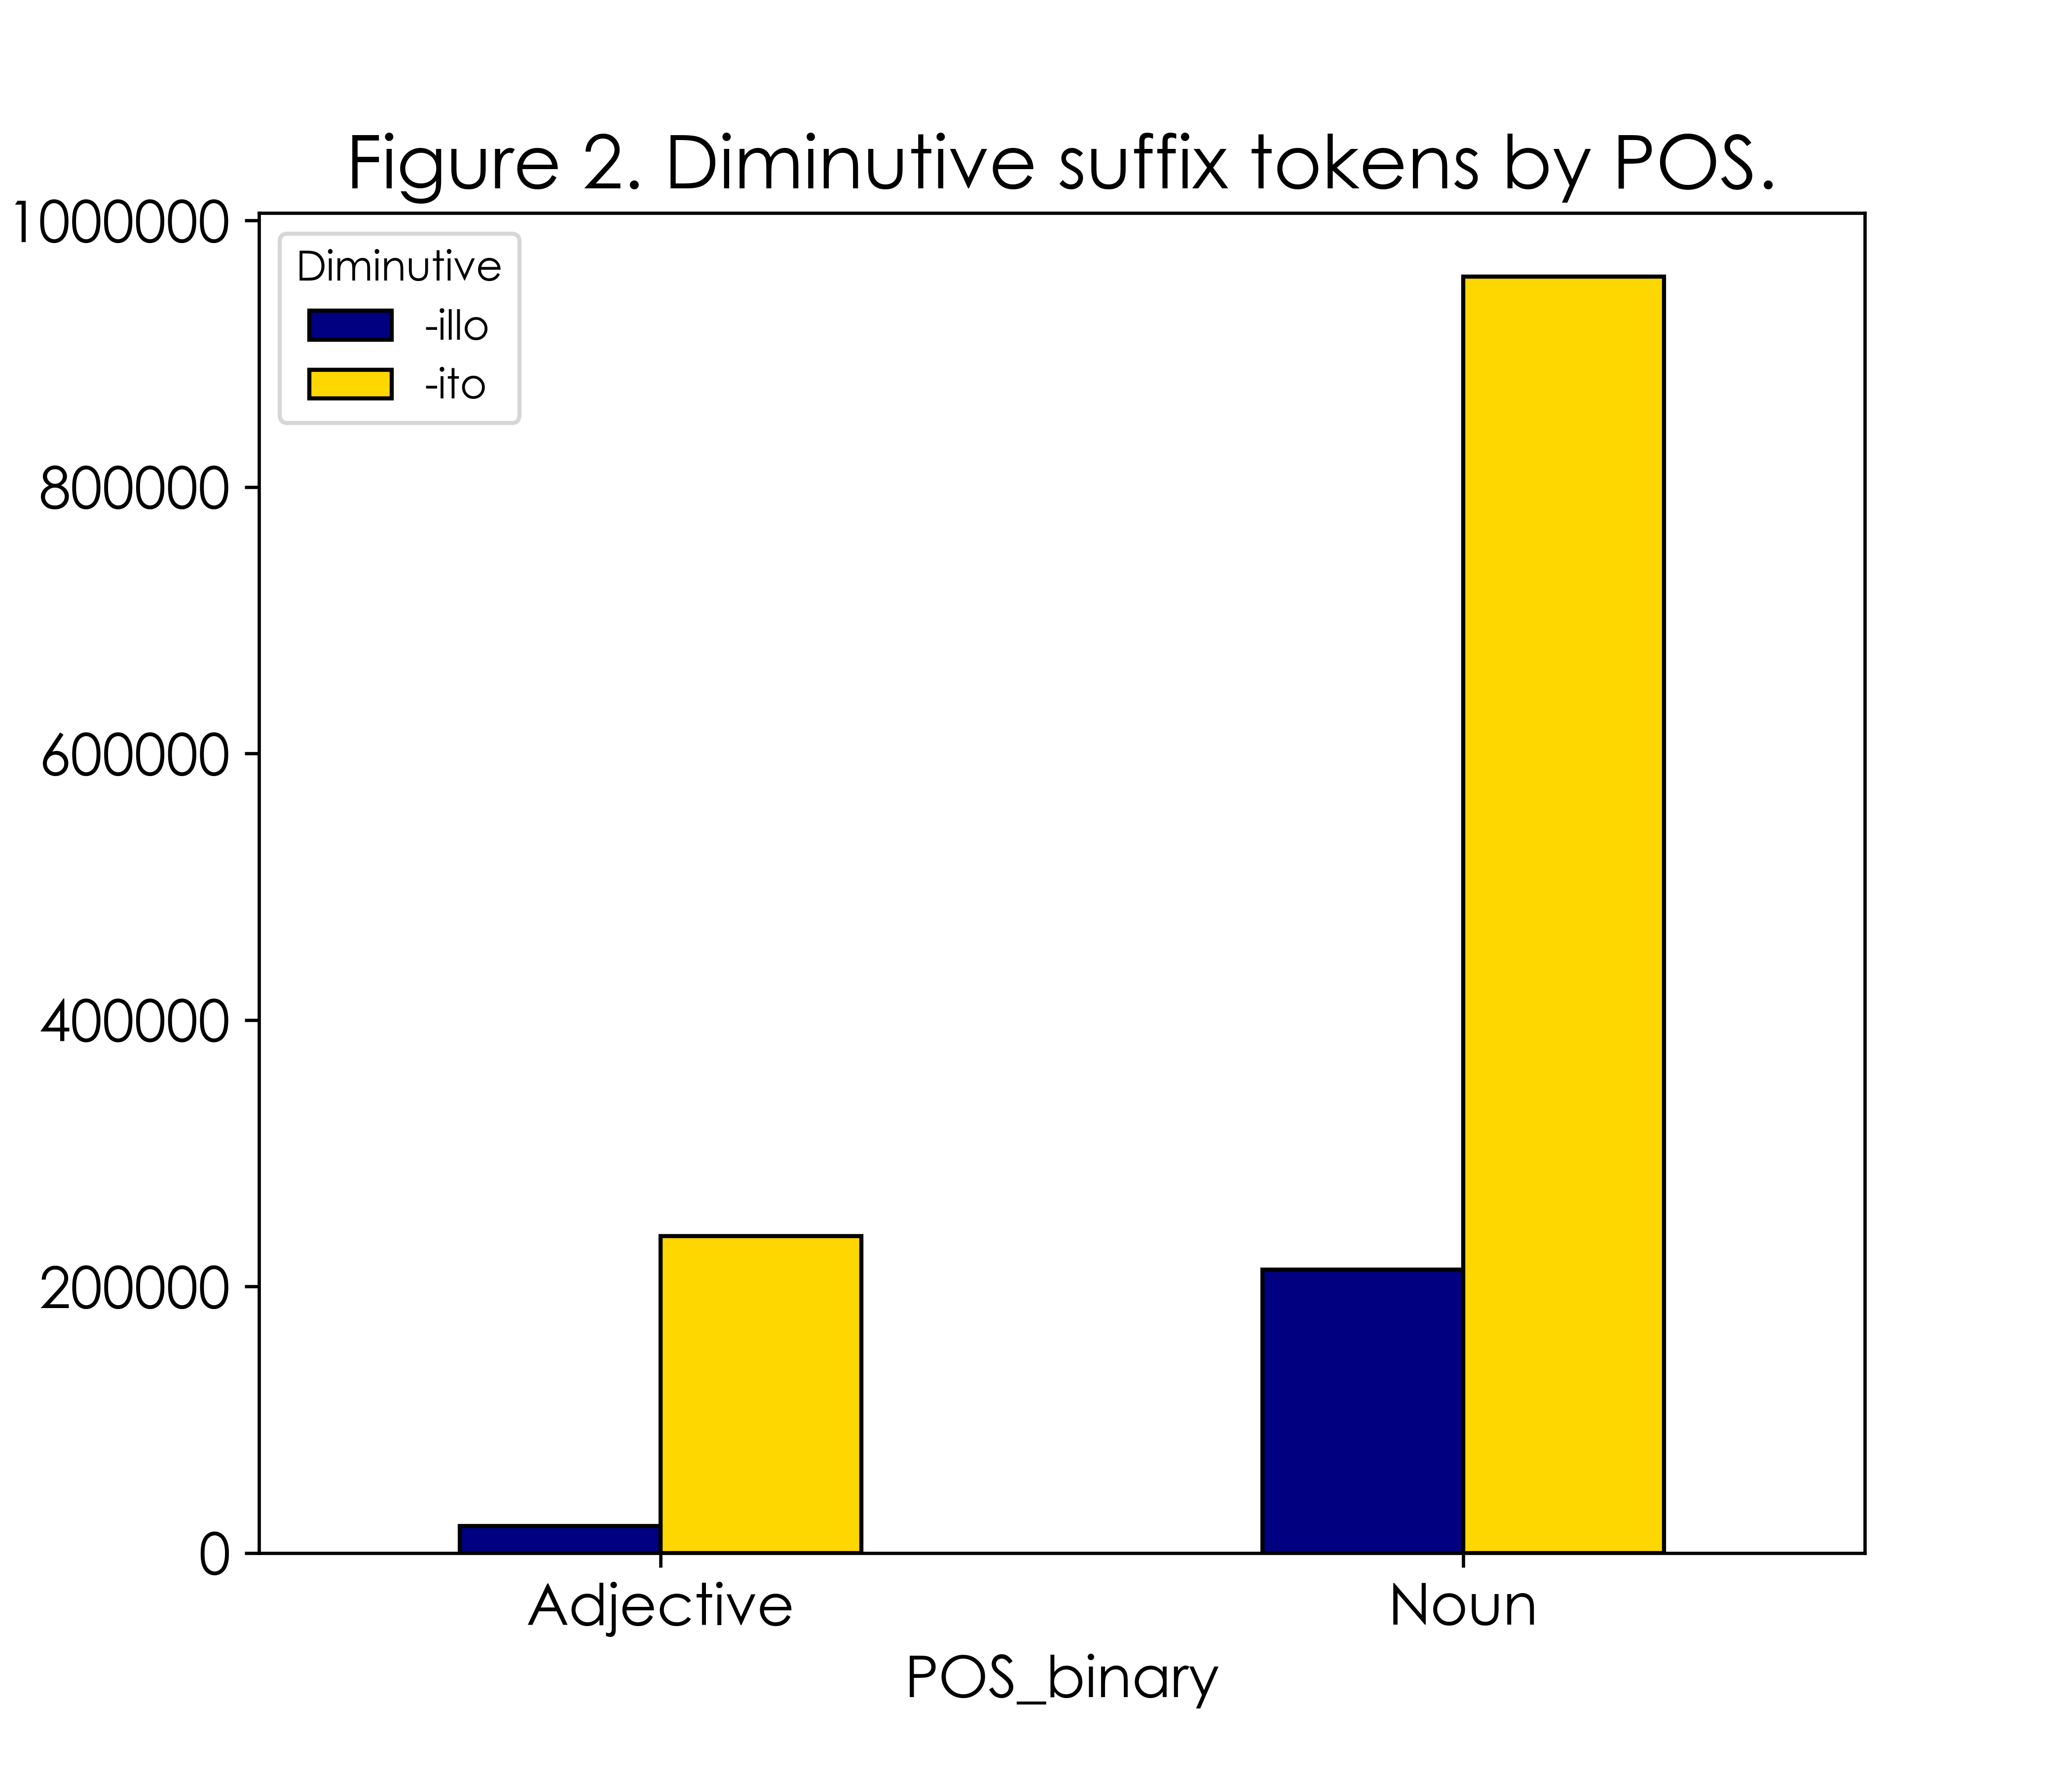

Slide 26
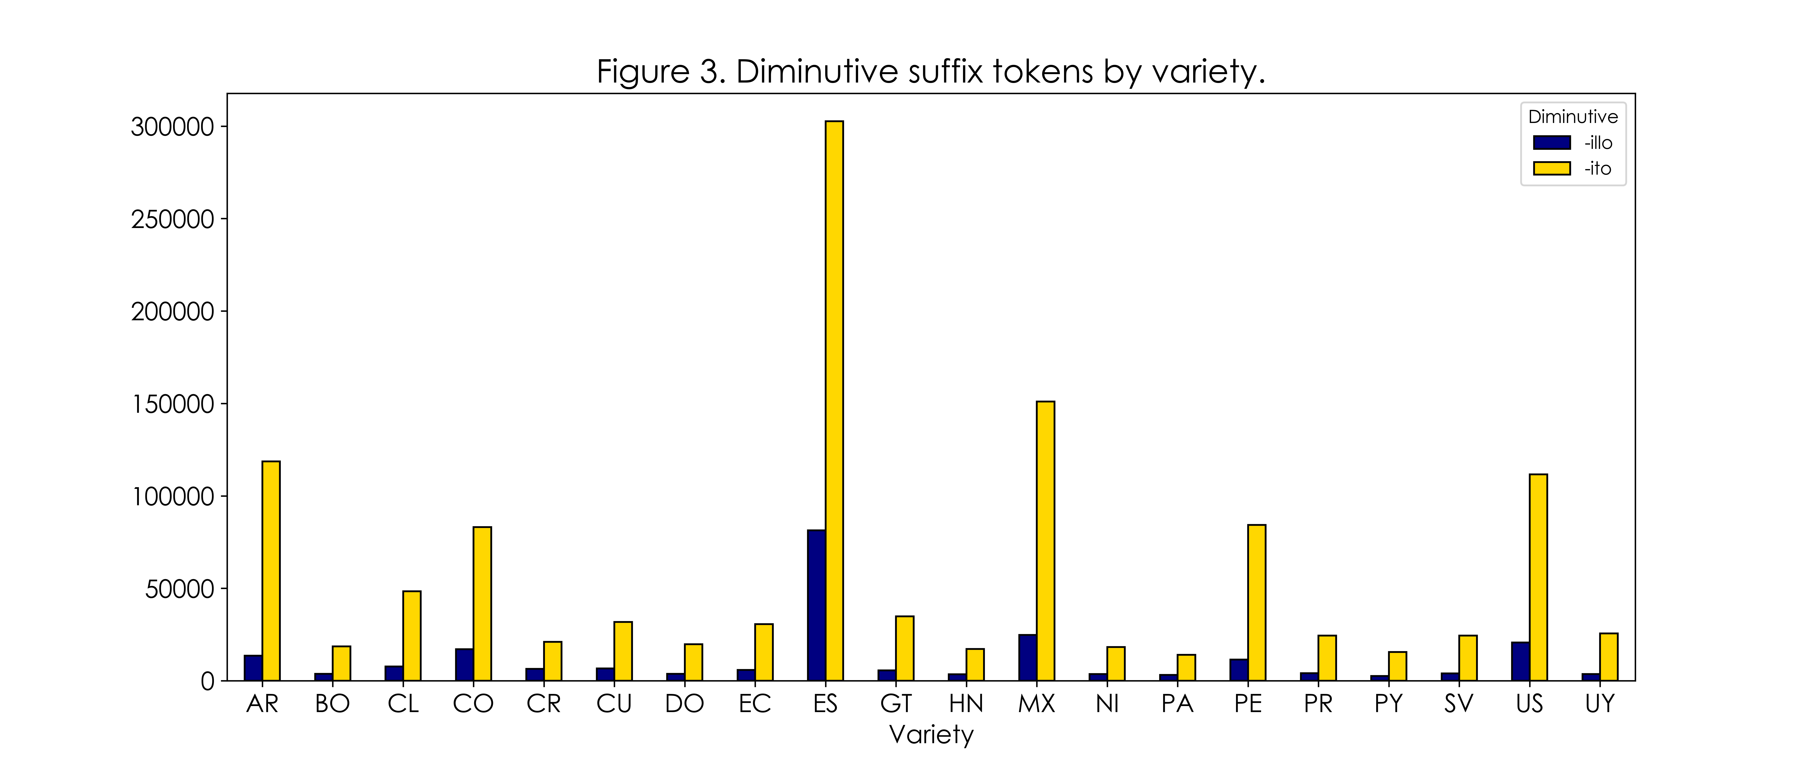

Slide 28
Statistical measures of productivity

Slide 29


Corpus processing
Extracted hapax legomena from the master data frame.
Created new summary data frame objects including token counts, type counts, hapax legomena counts, P, and P*.
Plotted differences across and within varieties.

Slide 30
Statistical measures of productivity
Realized productivity
Diminutive | Tokens | Types | Hapax | P | P*
-illo | 233202 | 13157 | 6513 | 2.79286 | 0.121974
-ito | 1195810 | 48930 | 26611 | 2.22535 | 0.498367

Slide 31
Statistical measures of productivity
Expanding productivity
Diminutive | Tokens | Types | Hapax | P | P*
-illo | 233202 | 13157 | 6513 | 2.79286 | 0.121974
-ito | 1195810 | 48930 | 26611 | 2.22535 | 0.498367

Slide 32
Statistical measures of productivity
Category-conditioned degree of productivity
Diminutive | Tokens | Types | Hapax | P | P*
-illo | 233202 | 13157 | 6513 | 2.79286 | 0.121974
-ito | 1195810 | 48930 | 26611 | 2.22535 | 0.498367

Slide 33
Statistical measures of productivity
Hapax-conditioned degree of productivity
Diminutive | Tokens | Types | Hapax | P | P*
-illo | 233202 | 13157 | 6513 | 2.79286 | 0.121974
-ito | 1195810 | 48930 | 26611 | 2.22535 | 0.498367

Slide 34
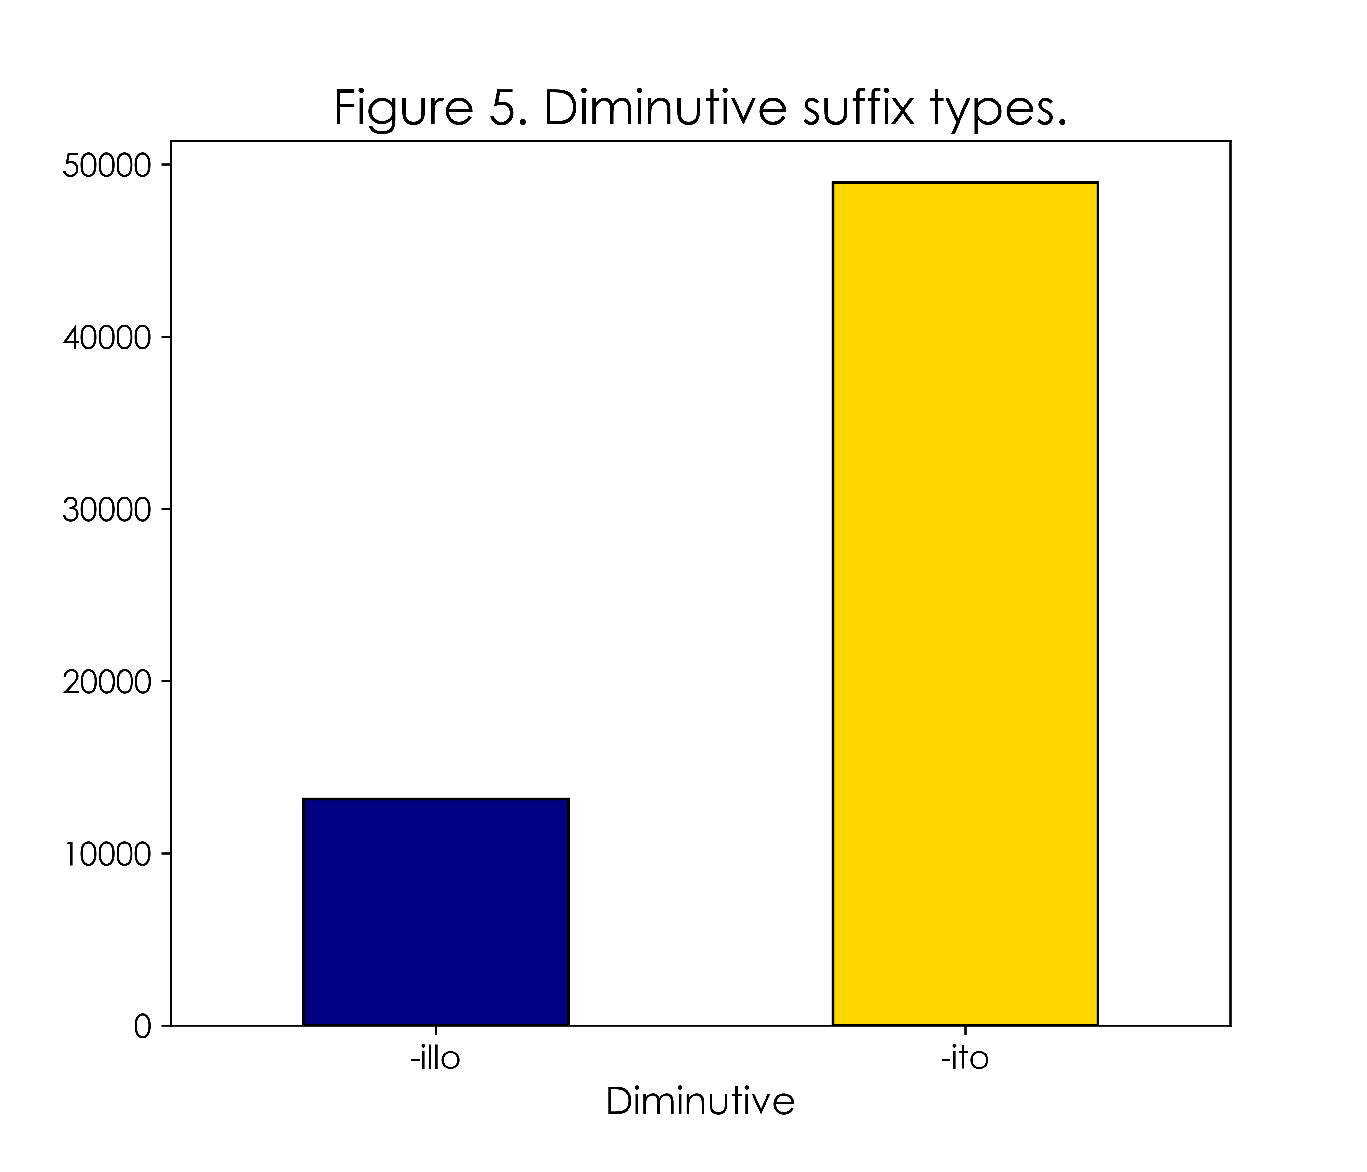
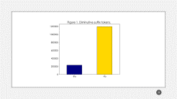
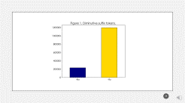

Slide 35
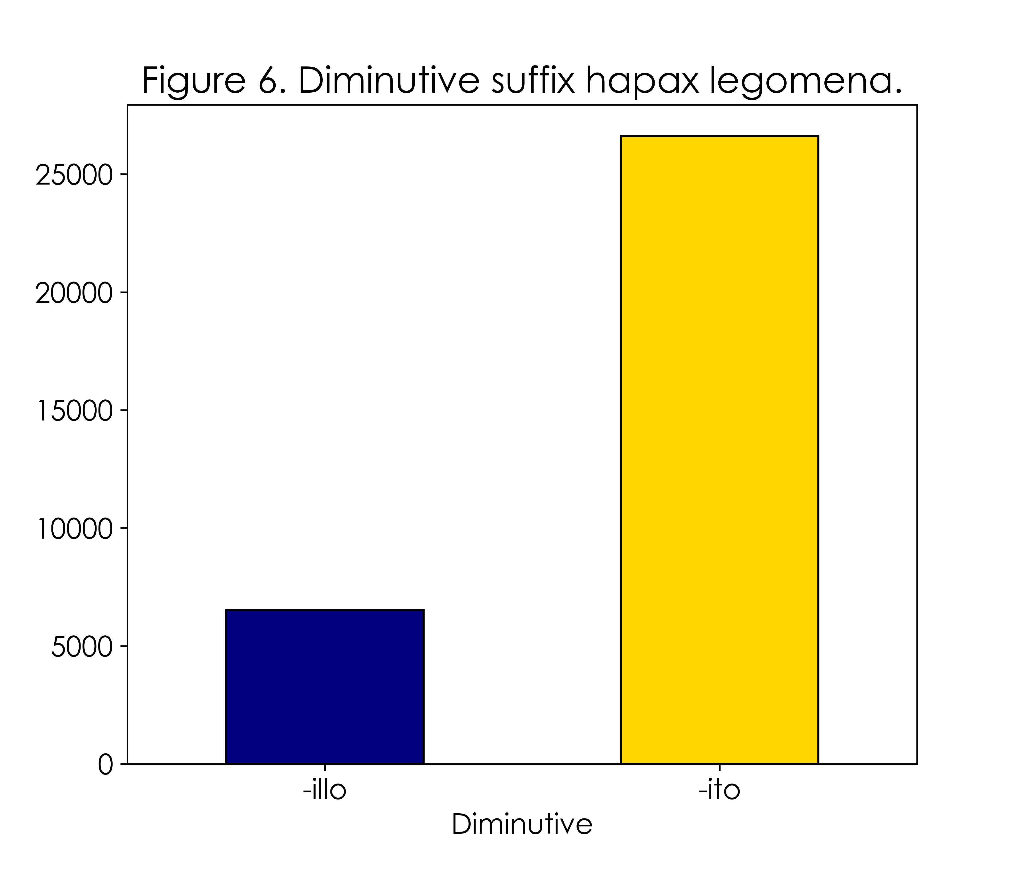

Slide 36
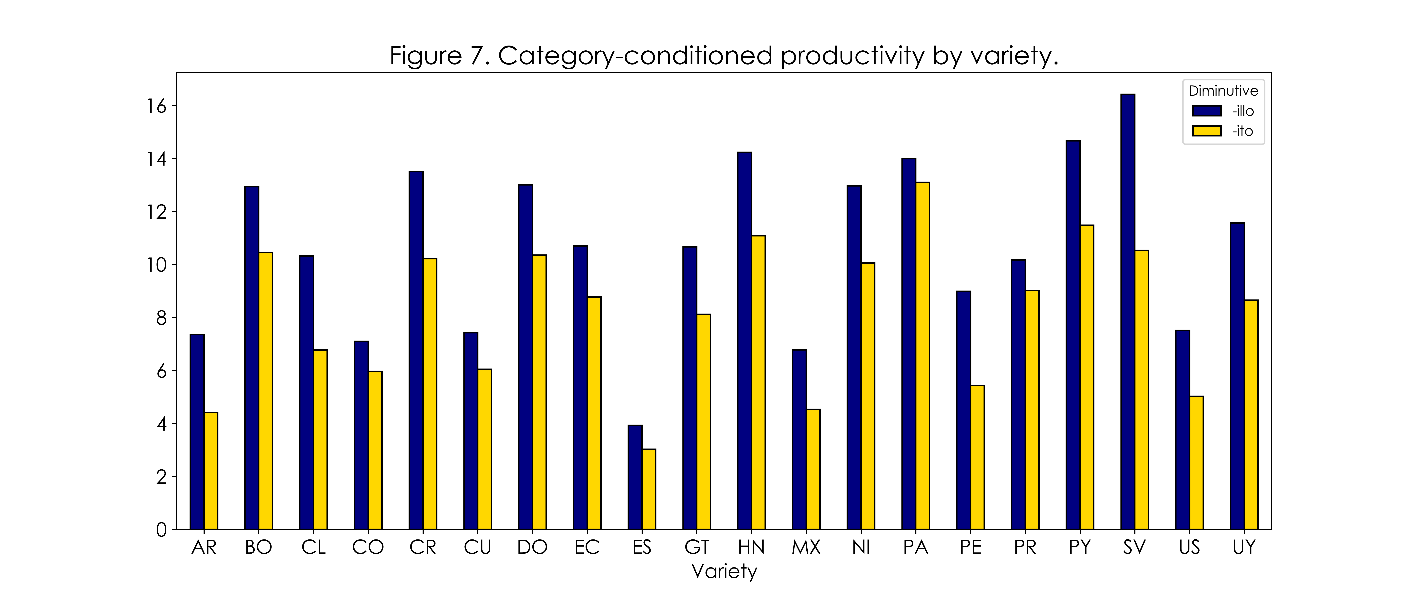

Slide 37
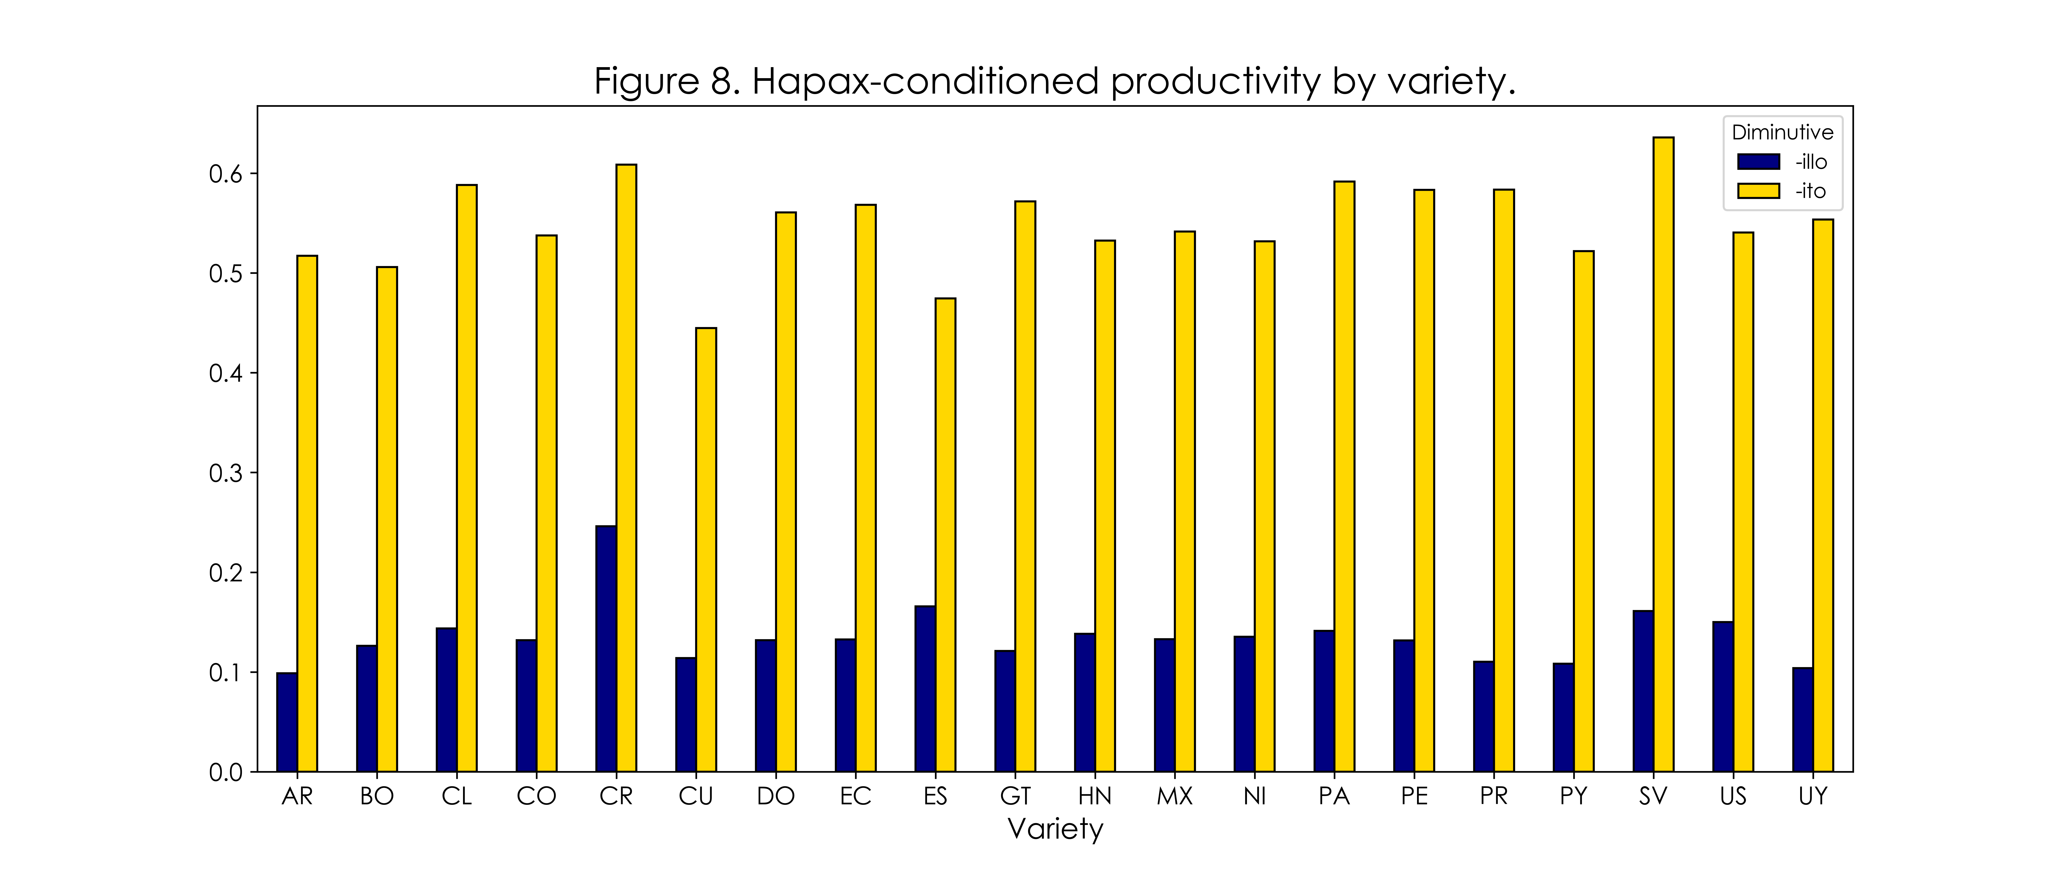

Slide 38
conclusions

Slide 39
conclusions
Across varieties: in terms of realized and expanding productivity, the numbers show that -ito is the bigger category and that it is overall attracting more new members.
The category-conditioned degree of productivity doesn't appear to fully capture the difference between the two suffixes in terms of occasionalisms.
This might be due to the fact that -illo has notoriously fewer tokens. Alternatively, the hapax-conditioned degree of productivity shows a far more noticeable difference.

Slide 40
conclusions
Within varieties: the numbers by variety follow the same trend as those of the master data frame. A few differences are worth noting, however.
Whereas P showed both suffixes in similar standing, the differences here are higher in favor -illo, particularly in countries such as Peru where it almost doubles -ito.
For P*, however, -ito remains the prevailing suffix in all varieties, although differences vary by country and might be worth looking at with inferential statistics.

Slide 41
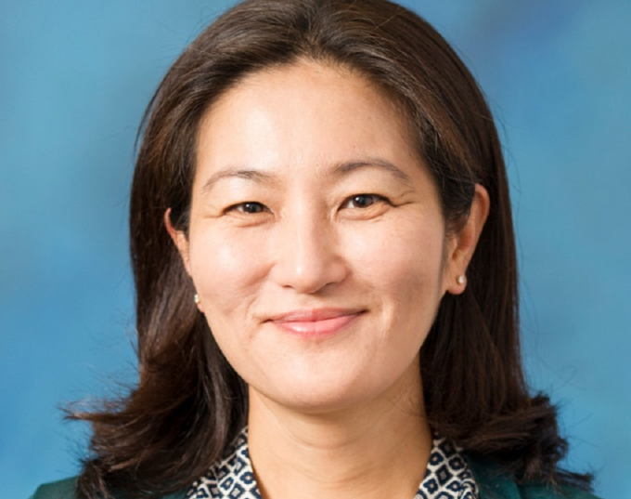
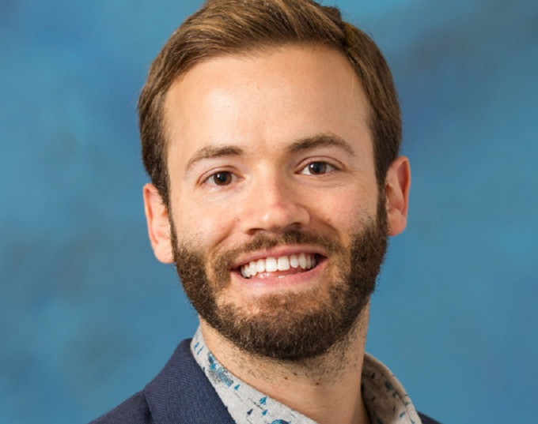
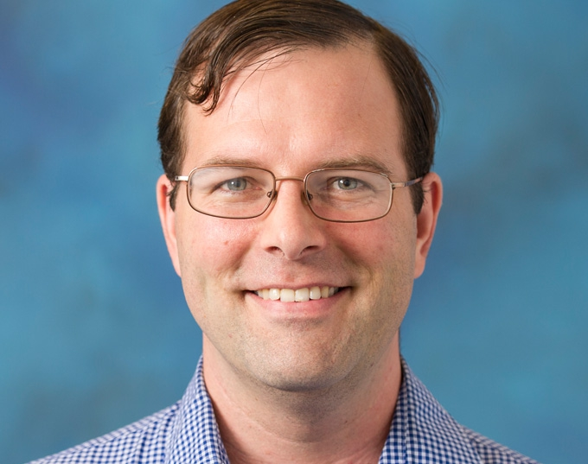
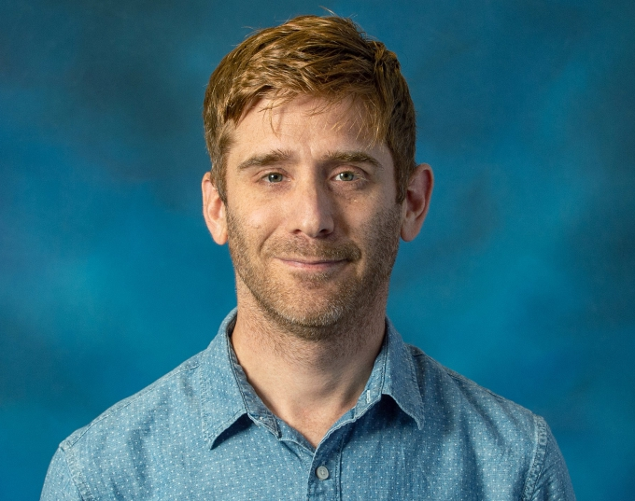
Acknowledgements
Dr. Na-Rae Han
Dr. Jevon Heath
Robert Henderson Language Media Center.
Dr. Matthew Kanwit
Ben Naismith
LING 2340 Spring 2020 peers.

Slide 42
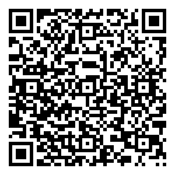
contact
Email: juanberrios@pitt.edu
Website: pitt.edu/~jeb358
GitHub: github.com/juanberrios

Slide 43
References
Baayen, H. (2009). Corpus linguistics in morphology: morphological productivity. In A. Lüdeling & M. Kyto (Eds.), Corpus Linguistics. An international handbook (pp. 900-919). Berlin: Mouton De Gruyter.
Bradley, T. G., & Smith, J. (2011). The phonology-morphology interface in Judeo-Spanish diminutive formation: A lexical ordering and subcategorization approach. Studies in Hispanic and Lusophone Linguistics, 4(2), 247-300.
Castro, O. (1998). La formación del diminutivo en español y en gallego: Procesos morfológicos simples; implicaciones teóricas complejas. In A. Acosta Félix, Z. Estrada Fernández, M. Figueroa Estava, & G. López Cruz (Eds.), IV Encuentro internacional de lingüística en el noroeste (pp. 135–159). Sonora, México: Universidad de Sonora.
Colina, S. (2003). Diminutives in Spanish: A morpho-phonological account. Southwest Journal of Linguistics, 22(2), 45-88.
Eddington, D. (2002). Spanish diminutive formation without rules or constraints. Linguistics, 40(2), 395-419.
Eddington, D. (2017). Dialectal variation in Spanish diminutives: A performance model. Studies in Hispanic and Lusophone Linguistics, 10(1), 39.
Elordieta, G., & Carreira, M. M. (1996). An optimality theoretic analysis of Spanish diminutives. Papers from the Regional Meetings, Chicago Linguistic Society, 32(1), 49-60.

Slide 44
References
Haspelmath, M., & Sims, A. D. (2010). Understanding morphology (2nd ed.). London, UK: Hatchette.
Hualde, J. I. (2013). Los sonidos del español. Cambridge: Cambridge University Press.
Lipski, J. M. (1994). Latin American Spanish. London: Longmans.
Náñez Fernández, E. (2006). El diminutivo. Historia y funciones en el español clásico y moderno. Madrid: UAM Ediciones.

